Slide 1
Hotel Management System
Batch- C2
16010120162 - Dhairya Ameria
16010120164 - Gaurav Kulkarni
16010120169 - Anisha Sah

Slide 2
Outline of the Project
Introduction
Problem statement
Software and Hardware requirement
System Architecture
Features of designed system
Snips From The Project/ Result
Conclusion/ Future prospects and scope of Improvement
References

Slide 3
Introduction
This project is Hotel Management System; the main aim of this project is to provide service to employees and administrator of the hotel. The administrator can serve the customer needs like enquiry about rooms, reservation process, vacating process, canceling the reservation, and placing a restaurant order by means of this system.
The system is intended to support day-to-day operations of hotel mangement by improving various processes of making reservations, assuring bills and providing service to the customers.

Slide 4
Problem Statement
The hotel management requires a computer software package to facilitate the automation of many manual tasks will be perform by the system itself.
The hotel contains a number of hotel rooms available for hire to guests. The information relevant to each room is
Room number
Basic price
Type of room (single, double, twin, executive, suite)
Potential guests can reserve room for a specified period using this. These reservation are handled by the receptionist as well as the user.
The potential guests requests the type of the room, arrival date, duration for departure date). If successful, the customer is informed the details and the price.

Slide 5
Software and Hardware Requirement
Software Requirements:
OPERATING SYSTEM: Windows 7 and above, Ubuntu v12.04 and above.
FRONT END: Python
Hardware Requirements:
PROCESSOR: Core i3 or above
RAM: 1 GB
HARD DISK: 160 GB Network Interface.

Slide 6
Features of the Designed System
Datetime--->In current booking it automatically takes current date and time
random---> Randomly generates any room number during the time of customer booking
Booking
Current as well as advanced.
See all the room prices and select according to your requirement and comfort.
In current booking it itself calculates your check in date time as well as check out date and time as per the number of days you stay.
Room information
Can see all the room information and the room types with the amenities available in each room.

Slide 7
Restaurant
Order your favorite food and drinks with bill automatically added to the checkout bill.
Payment
Asks for all the payment methods available and you can pay according to your convenience and choice .
Generates the receipt with all the details.
Customers information
Just enter the room number and you will be able to see all the details of the customer.
Change or upgrade room
You will be able to increase your booking span as well as change or upgrade your room.
All the Functions are linked from the Room number to restaurant to customers record

Slide 8
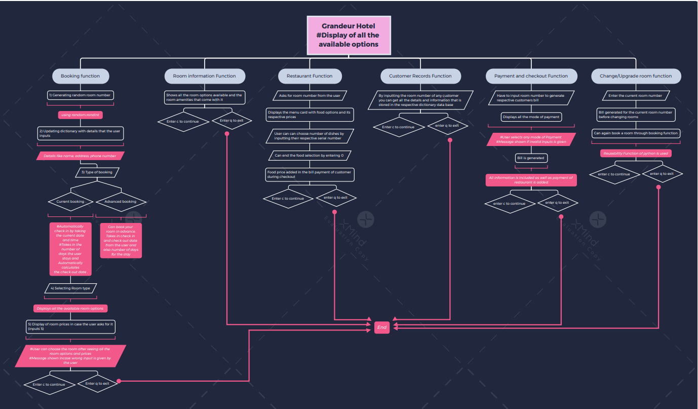
System Architecture- Flow of the Program

Slide 9
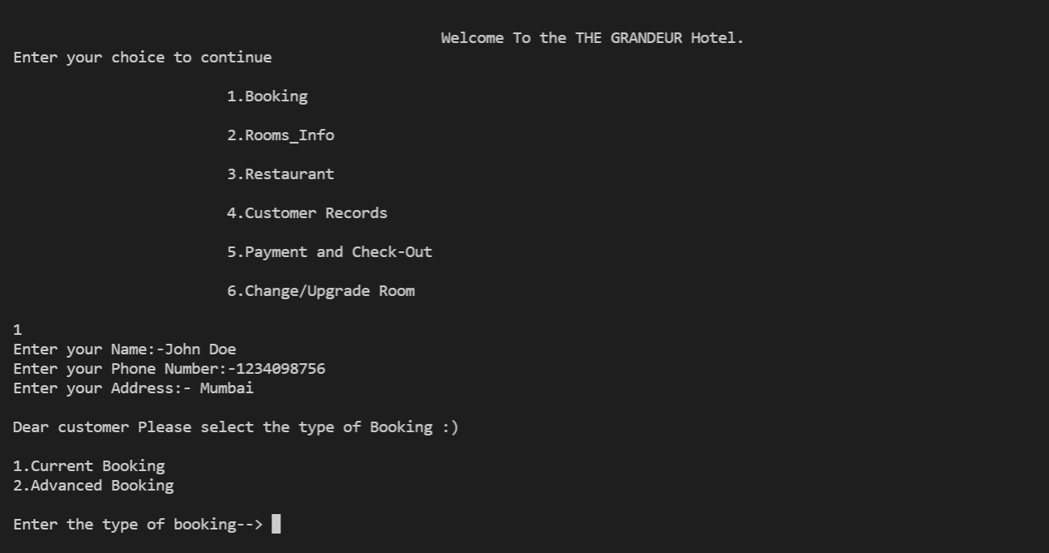
Snippets of the Output
Booking function:

Slide 10
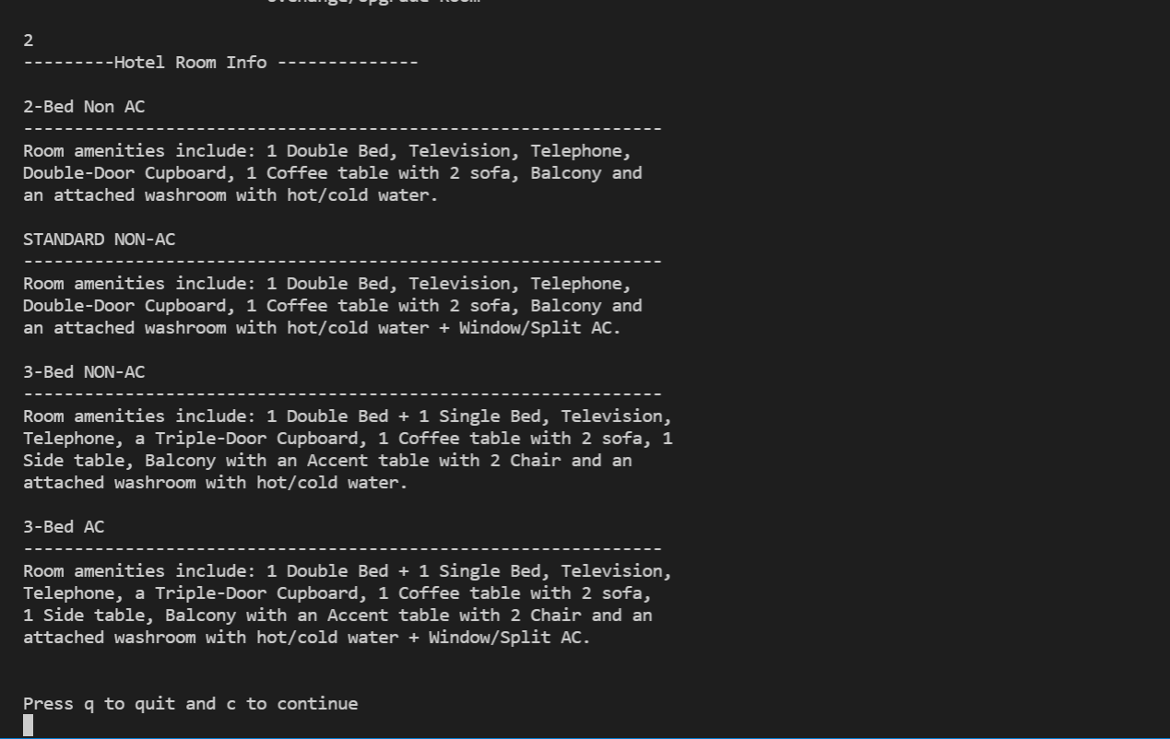
Snippets of the Output
Room Information function:

Slide 11
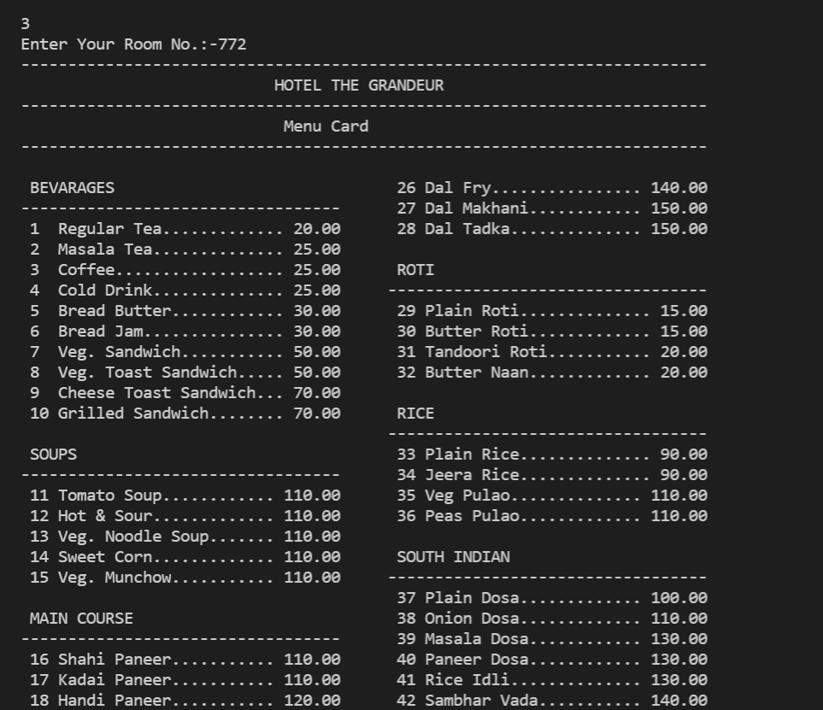
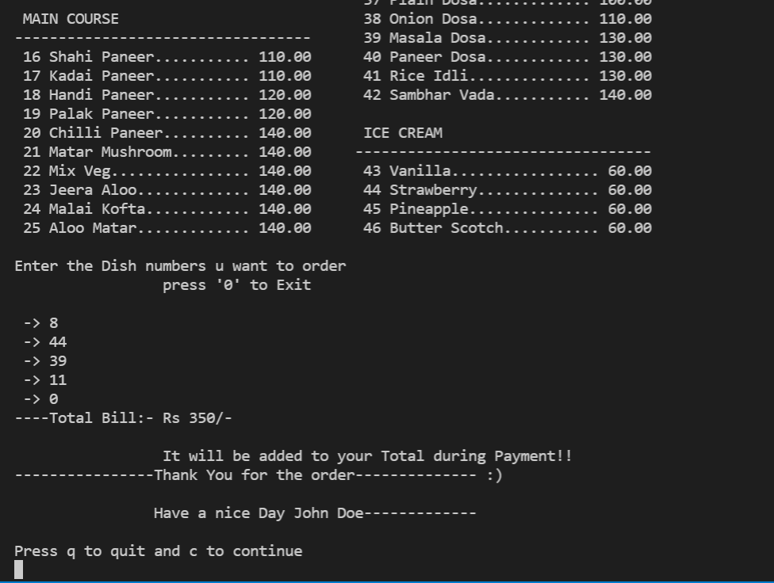
Snippets of the Output
Restaurant function:

Slide 12
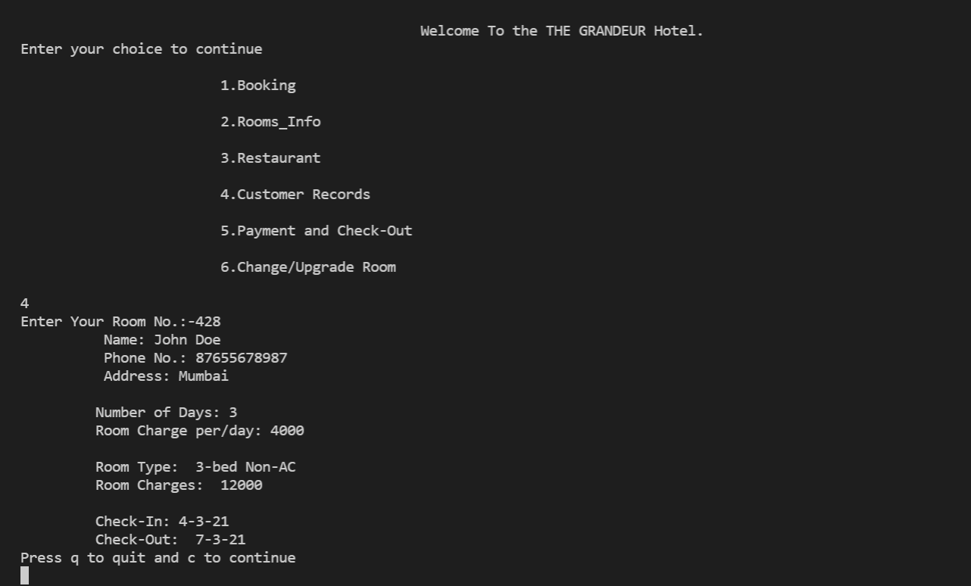
Snippets of the Output
Customer Records function:

Slide 13
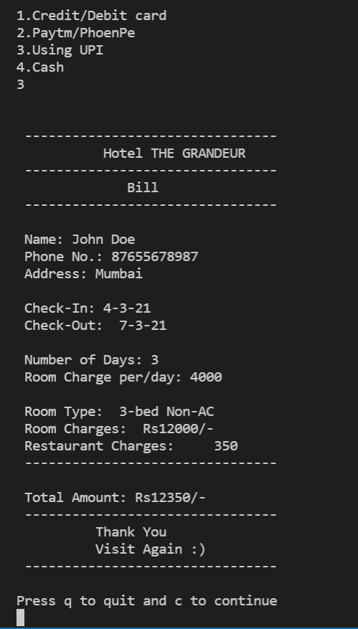
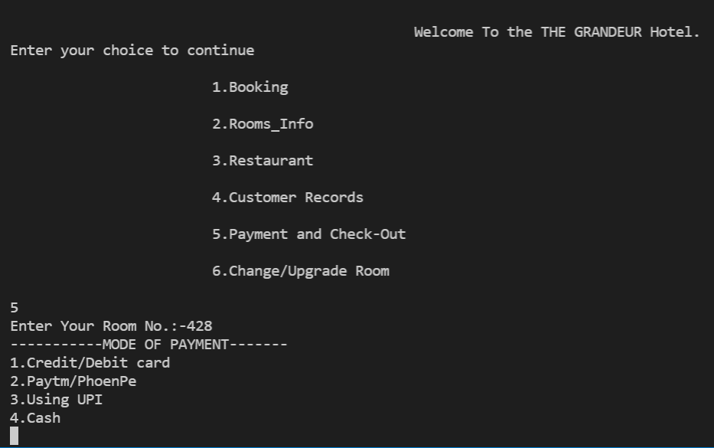
Snippets of the Output
Bill generation/Payment function:

Slide 14
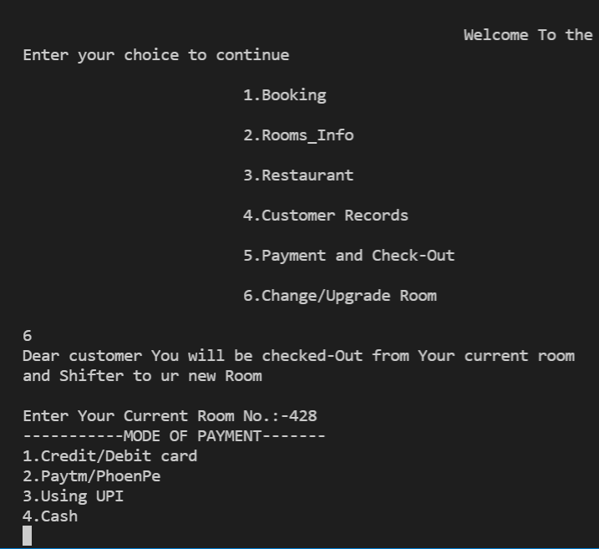
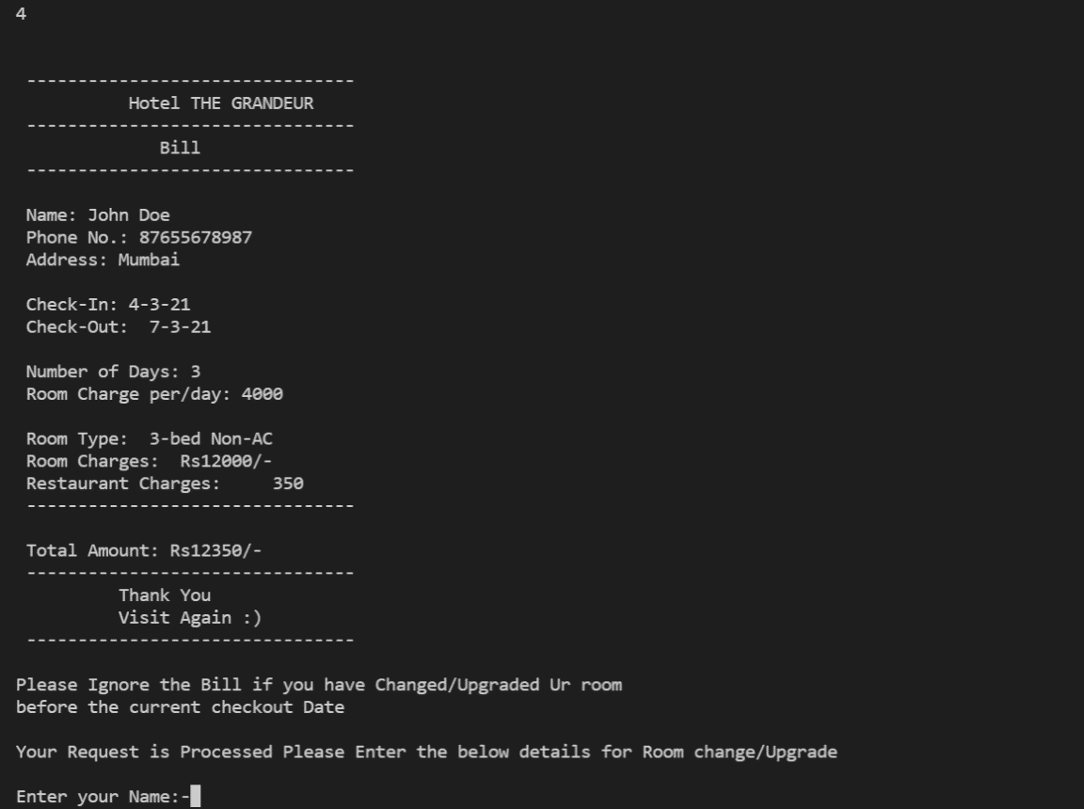
Snippets of the Output
Change/Upgrade Room function:

Slide 15
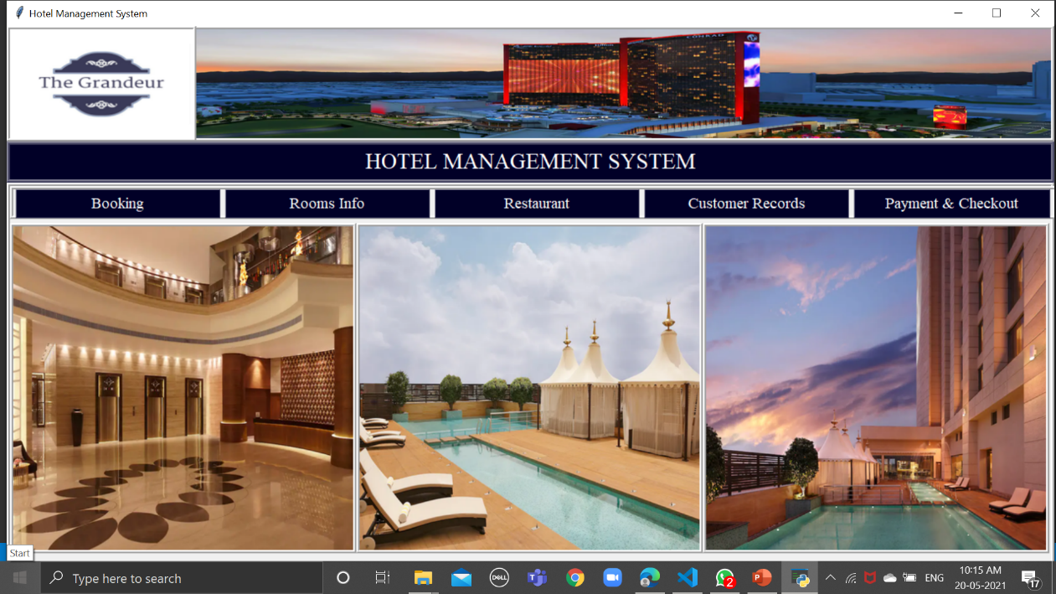
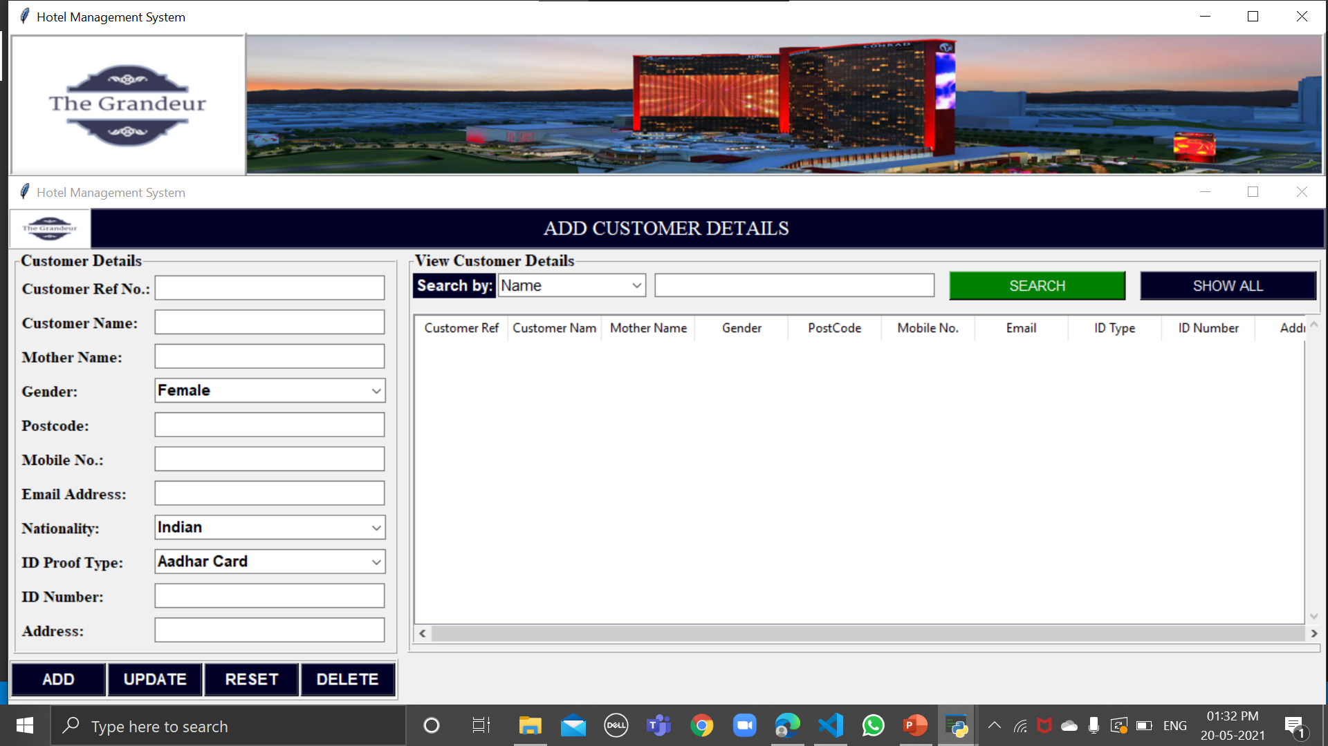
Conclusion/ Future prospects and scope of Improvement
The System implemented satisfies the basic and important needs in any hotel management and works well.
It is an efficient and liable system but it also lacks graphics and design. So, we’ll be going ahead with the same project and try to implement a more efficient System and use gui as well.
We have already made our homepage using gui.

Slide 16
References
GitHub Repositories
Wikipedia
Stackoverflow
Scholarworks.lib.csus.edu
Researchgate.com
GeeksforGeeks

Slide 17
Thank You

